Slide 1

Skills for Success with Microsoft Office 2016 Volume 1
by Margo Chaney Adkins, Catherine Hain, Lisa Hawkins, and Stephanie Murre Wolf
Access Chapter 3
Create Forms
Notes:
Skills for Success with Microsoft Office 2016 Volume 1

Slide 2
Skills
Use the Form Wizard
Use Forms to Modify Data
Format Forms in Layout View
Add Controls and Conditional Formatting
Use the Form Tool
Notes:
The skills of this chapter are:
Use the Form Wizard
Use Forms to Modify Data
Format Forms in Layout View
Add Controls and Conditional Formatting
Use the Form Tool
The skills continue on the next slide.

Slide 3
Skills (cont.)
6. Work with Tabular Layouts
7. Add Input Masks
Change Data in One-to-Many Forms
Create Forms from Queries
Create Navigation Forms
Notes:
Additional skills include:
Work with Tabular Layouts
Add Input Masks
Change Data in One-to-Many Forms
Create Forms from Queries
Create Navigation Forms

Slide 4
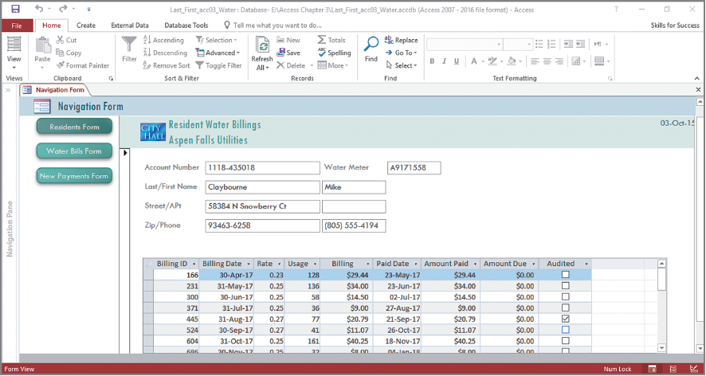

Outcome
Notes:
Using the skills in this chapter, you will create an Access form like this.

Slide 5
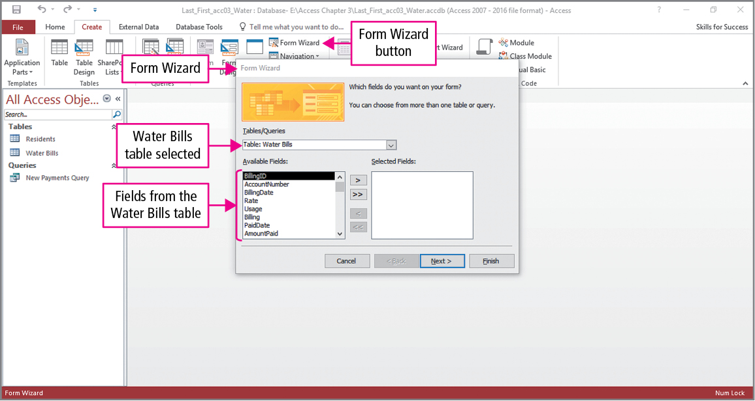
Skill 1: Use the Form Wizard
Notes:
Access has several tools for creating forms. We will begin with the Form Wizard, which is an efficient method when all the fields from a table are not needed.
To display the wizard, click Form Wizard in the Forms group on the Create tab. You select the tables or queries for which the form will be used. In this example the Water Bills table is selected, and its fields are displayed under Available Fields.

Slide 6
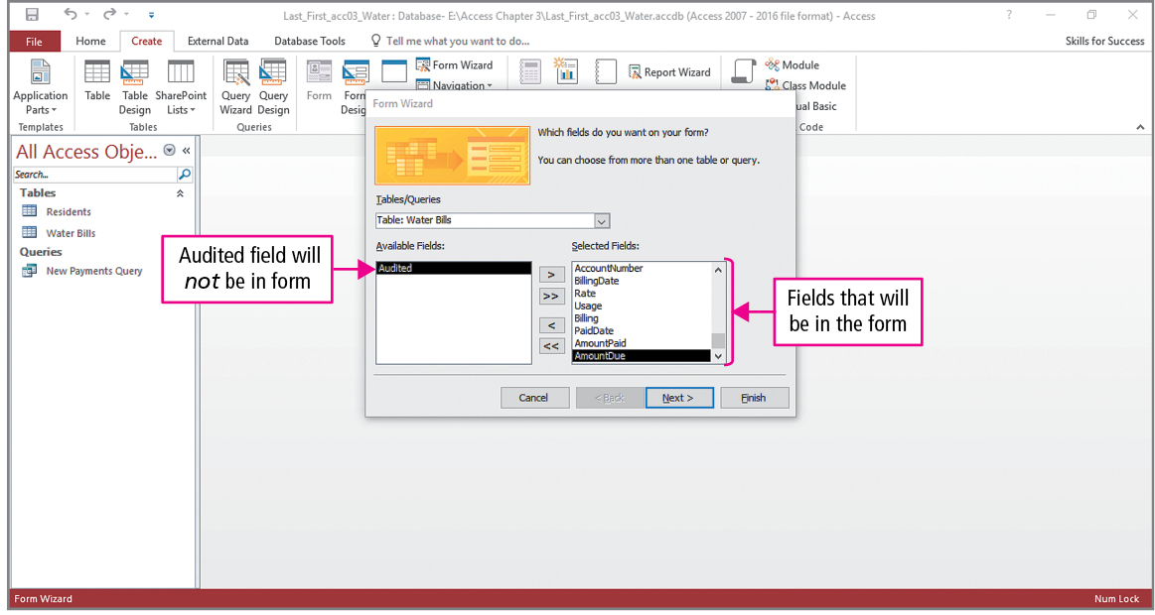
Skill 1: Use the Form Wizard (cont.)
Notes:
Fields can be moved to Selected Fields by either double-clicking the field name or using the Move button. As seen in the slide, all but one field have been moved.

Slide 7
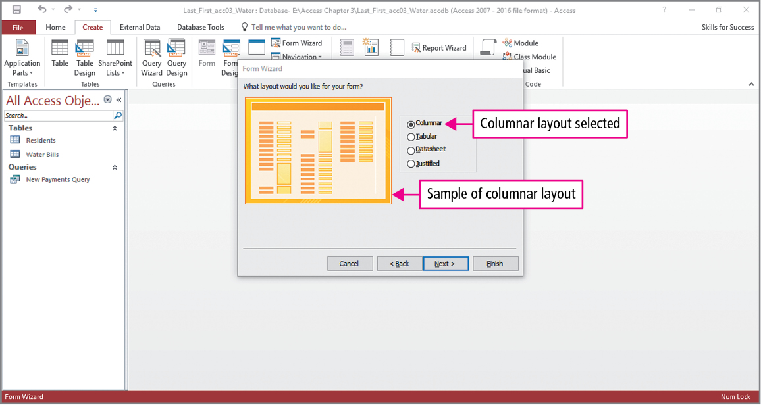
Skill 1: Use the Form Wizard (cont.)
Notes:
In this step, the layout—how data and labels are arranged in a form or report—is selected. The columnar layout places labels in the first column and data in the second column. In the next step, the form is named Water Bills Form and the wizard is closed.

Slide 8
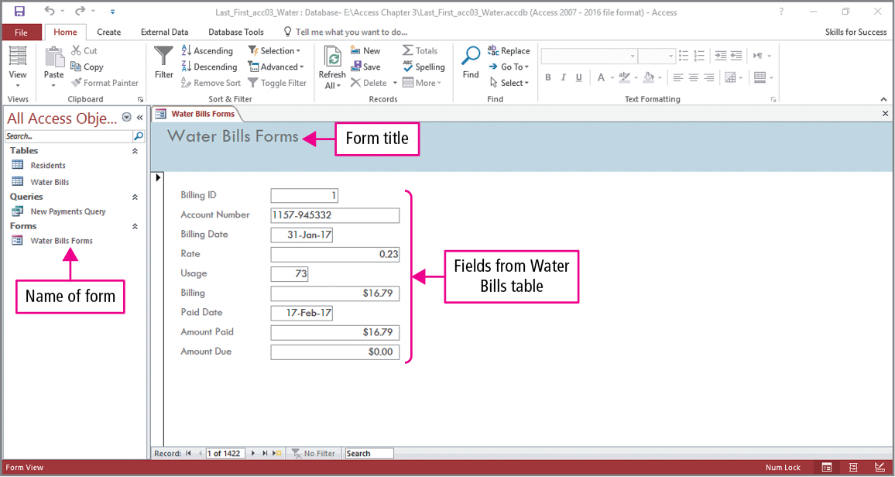
Skill 1: Use the Form Wizard (cont.)
Notes:
This slide shows the form in Form view, and as you can see, the left column contains labels, the second contains the data, and the form name appears in the Navigation Pane and is the form’s title.

Slide 9
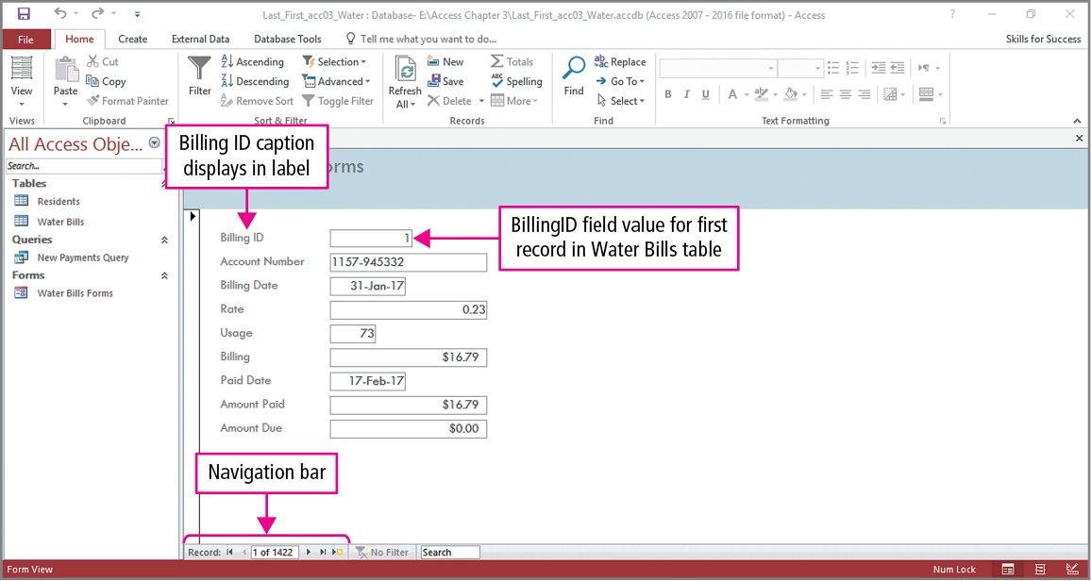
Skill 2: Use Forms to Modify Data
Notes:
Forms are designed to input data into tables. When data are edited or records are added, the changes are automatically reflected in the underlying table.
We begin by looking at a form in Single Form view—a view that displays one record at a time with field names in the first column and the field values in the second column. If a field has a caption property assigned, that value will display in place of the field name. In the next slide, a change will be made to the second record. The Next Record button in the Navigation bar will be used to advance to the second record.

Slide 10
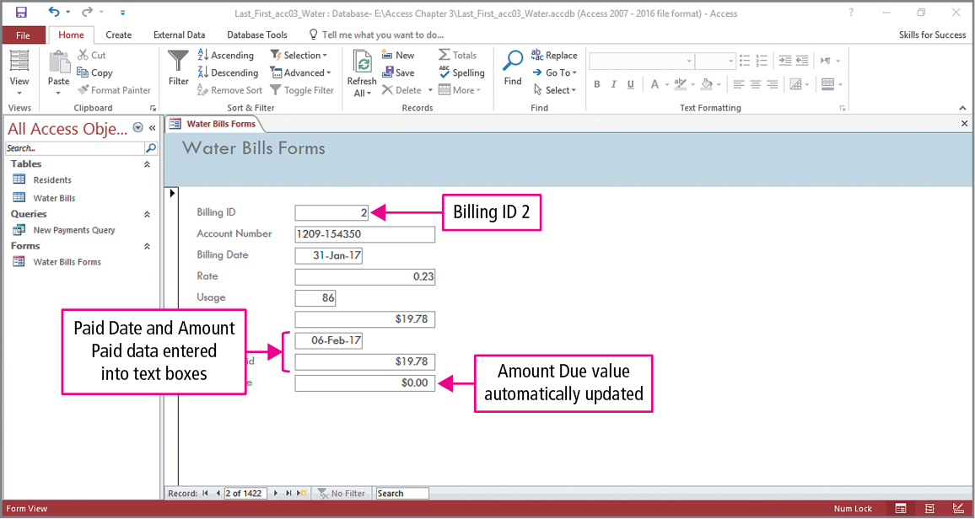
Skill 2: Use Forms to Modify Data (cont.)
Notes:
To make changes, click in the box containing the data and enter a new value. In this example, the Paid Date has been changed to 06-Feb-17 and the Amount Paid has been changed to 19.78. When the Amount Paid is entered, the Amount Due is automatically updated. Notice its value is zero, since the amount paid and the amount due are the same.

Slide 11
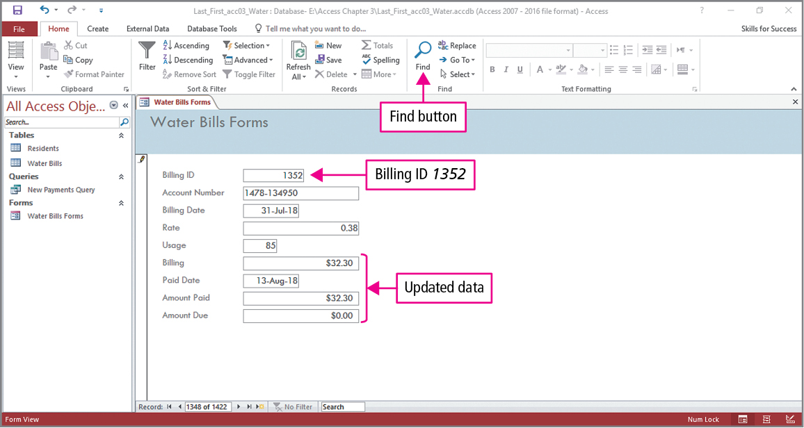
Skill 2: Use Forms to Modify Data (cont.)
Notes:
Looking at the bottom of the Access window, you can see that there are 1422 records, and we wish to view Billing ID 1352. Instead of clicking the Next Record button over a thousand times, we would use Find. Select the field, and then click Find in the Find group on the HOME tab to display the Find and Replace dialog box. In the dialog box, you would type 1352 in the Find What box and press Enter. Once at the correct record, similar changes are made to the two fields.

Slide 12
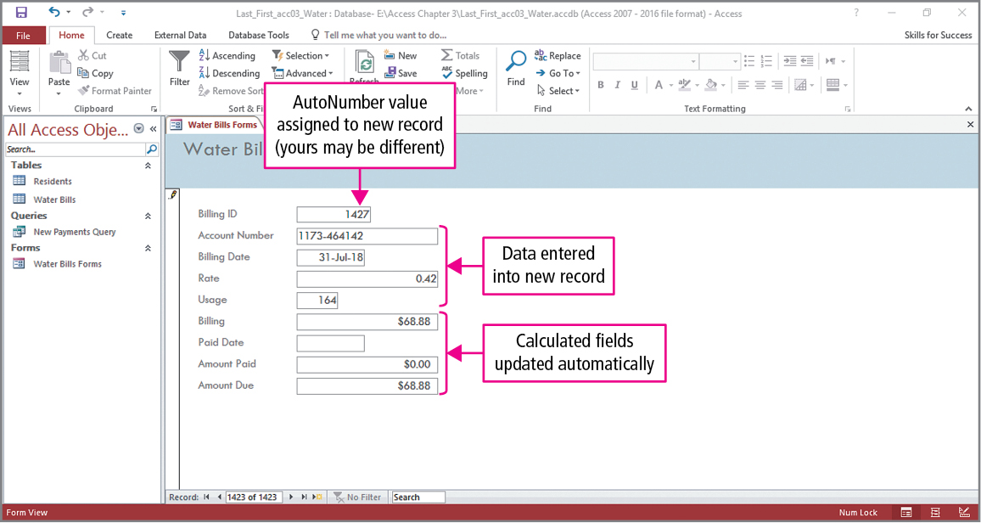
Skill 2: Use Forms to Modify Data (cont.)
Notes:
In this slide, a new record will be added to the table using the form. To do this, the New (blank) Record button in the Navigation bar would be clicked, and the data shown in the slide would be entered into the record.

Slide 13
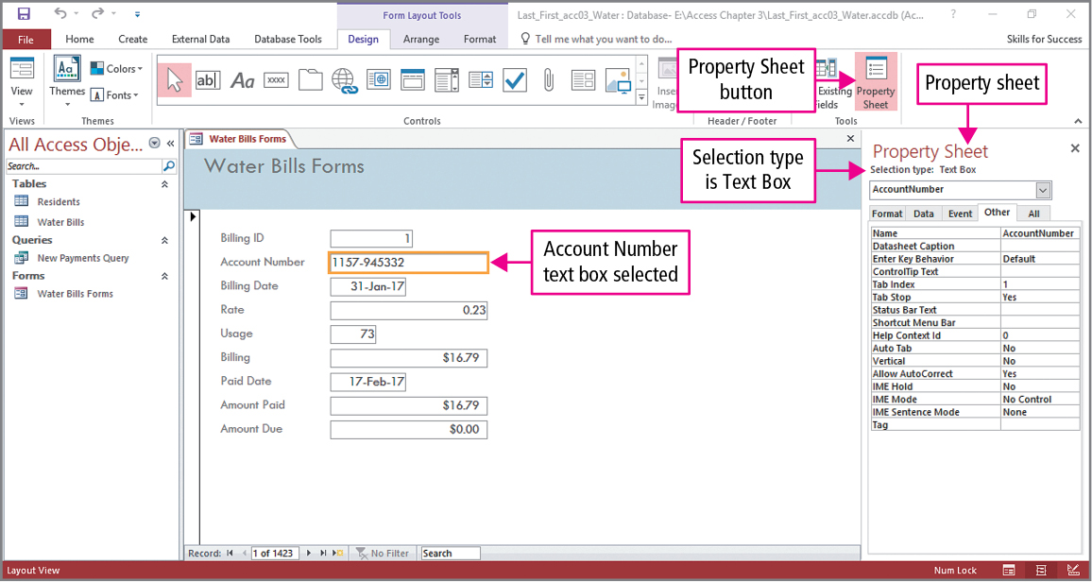
Skill 3: Format Forms in Layout View
Notes:
We were viewing the form in Form view and will now switch to Layout view. In Layout view, you can select controls and format them.
The two controls shown in the slide are a label, which is a control in a form or report that describes other objects in the report or form, and a text box, which is a control in a form or report that displays the data from a field in a table or query.
Formatting is done by clicking the View button in the Views group on the Home tab. To make changes to the layout, you would click Property Sheet in the Tools group on the Design tab to open the Property Sheet pane. Clicking the First Record button on the Navigation bar returns us to the first record. In this example, the AccountNumber text box has been clicked, causing its Property Sheet to be displayed.
Before going to the next slide, notice the alignment of the text in the AccountNumber text box.

Slide 14
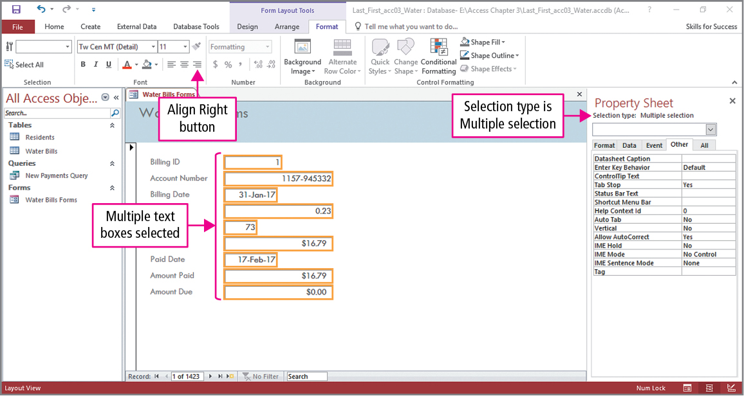
Skill 3: Format Forms in Layout View (cont.)
Notes:
In this slide, the data shown in the AccountNumber text box will be realigned. With the AccountNumber text box control selected, the Align Right button in the Font group on the Format tab would be clicked.
Sometimes you may want to apply the same formatting to several controls at the same time. This is done by clicking the first control and then pressing and holding Shift while clicking the other controls with the pointer. In the example shown in the slide, Billing ID was clicked first and then the next eight controls were selected.

Slide 15
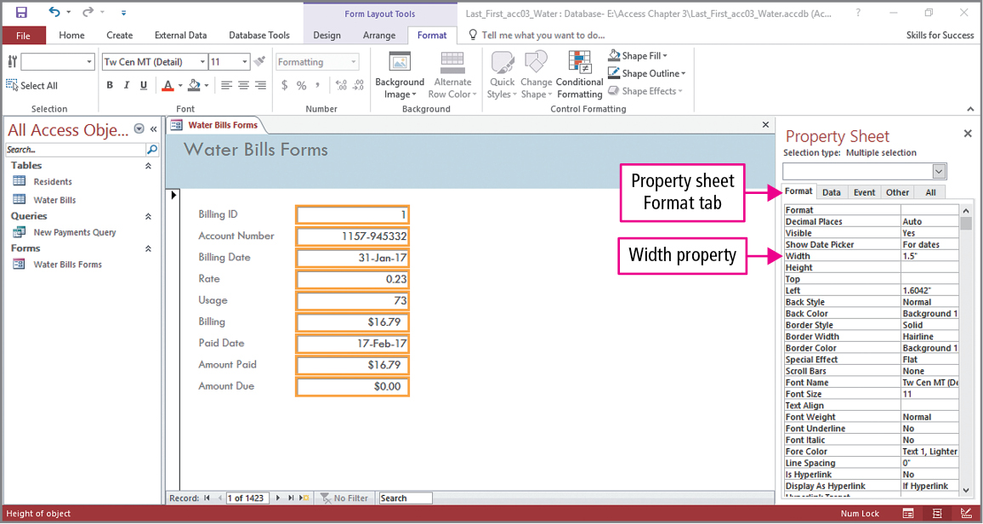
Skill 3: Format Forms in Layout View (cont.)
Notes:
In this example, the width of all the selected text boxes will be changed. On the property sheet Format tab, click in the Width box, type 1.5" and press Enter. As seen in the slide, all text boxes now have a width of 1.5”.

Slide 16
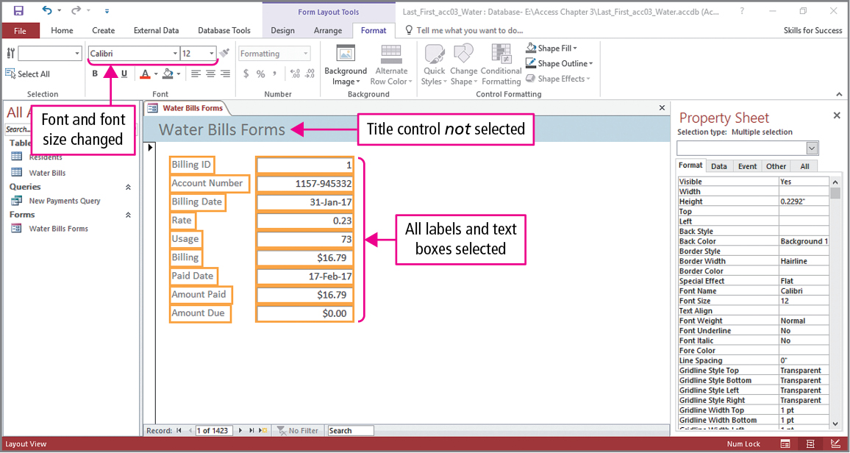
Skill 3: Format Forms in Layout View (cont.)
Notes:
On this slide, the font and font size will be changed for selected controls. Click Select All in the Selection group on the Format tab to select all form controls. Clicking the Font arrow in the Font group displays a list of fonts. In the text example, Calibri is chosen. To deselect certain controls, press and hold Ctrl and click those controls. In this example, Title is deselected. With the other controls still selected, clicking the Font Size arrow displays a list of sizes. In the text example, the size is increased to 12.

Slide 17
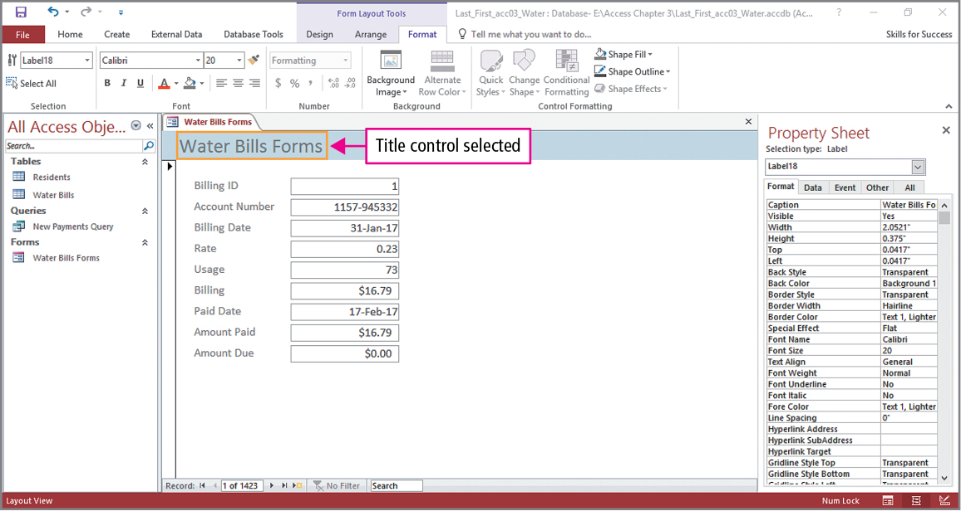
Skill 4: Add Controls and Conditional Formatting
Notes:
Controls such as logos and titles can be added to forms, and we will see how to do this in this skill. We will also see how to apply conditional formatting, which can be used to format values so when a condition is true, the value will be formatted differently than when the condition is false.
In preparation to adding a logo to the form title, we have to remove the existing one by selecting the Title control, which is indicated in the slide by the orange border and then pressing Delete.

Slide 18
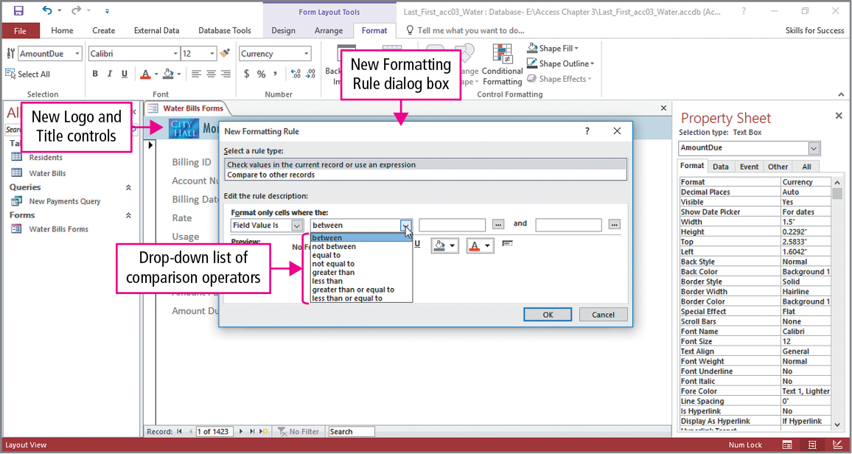
Skill 4: Add Controls and Conditional Formatting (cont.)
Notes:
In this example, the logo is in a file, so we need to locate it and add its image. Click Logo in the Header / Footer group on the Design tab to open the Insert Picture dialog box. In the Insert Picture dialog box, navigate to the location of the file and select it. Along with the logo, the title will be changed. This is done by clicking Title in the Header / Footer group and typing the new title. This completes the title portion shown in the slide.
We now focus on adding conditional formatting. Our goal is to have any negative balances indicated in red. To do this, we begin by selecting the Amount Due text box, and clicking Conditional Formatting in the Conditional Formatting group on the Format tab to display the Conditional Formatting Rules Manager. In the manager, click New Rule to display the New Formatting Rule dialog box shown in the slide. Click the second arrow to display a drop-down list of comparison operators.

Slide 19
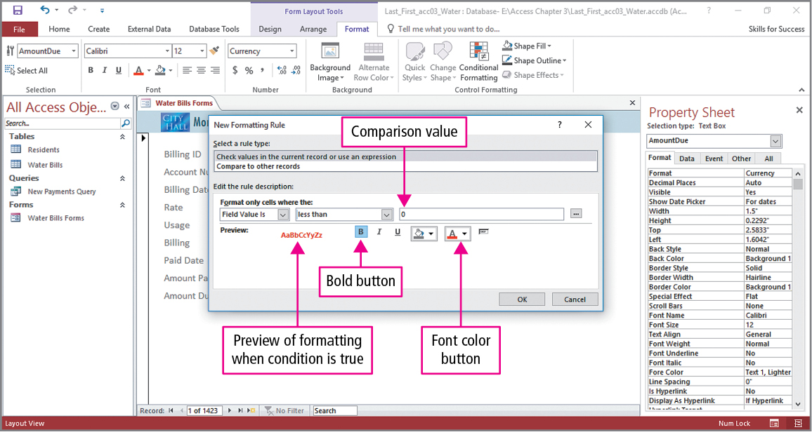
Skill 4: Add Controls and Conditional Formatting (cont.)
Notes:
Remember our goal; what are negative numbers? They are numbers that are less than zero. Less than is selected from the conditions list and 0 is typed in the third box. Click the Font color arrow to select the color, which will be red. To really emphasize these negative balances, they can be made bold by clicking the Bold button.

Slide 20
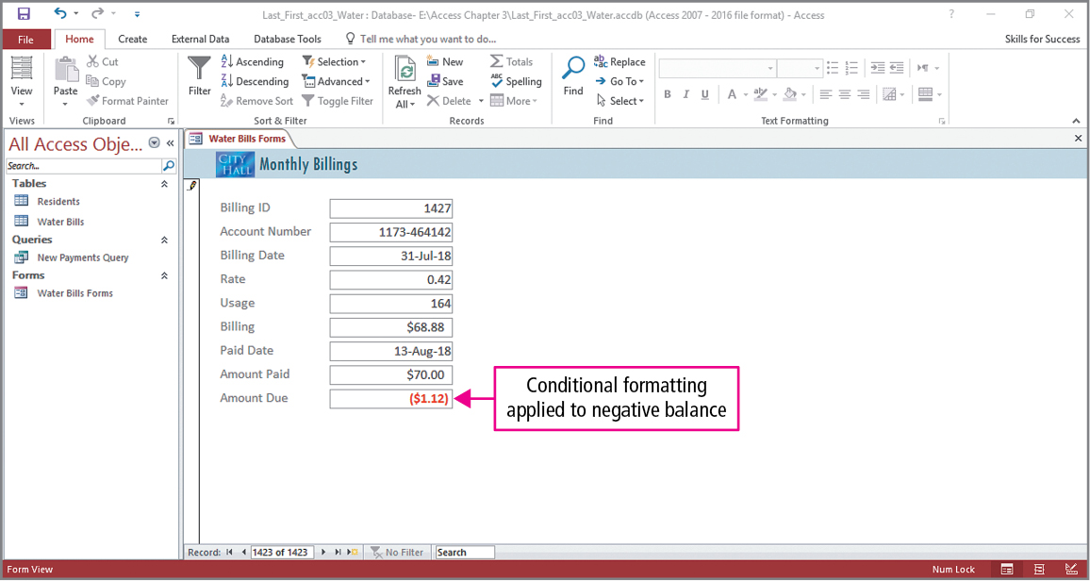
Skill 4: Add Controls and Conditional Formatting (cont.)
Notes:
We now test our formatting. Return to Form view, click the Last Record button in the Navigation bar, and enter the values in the text; we clearly see a negative Amount Due balance.

Slide 21
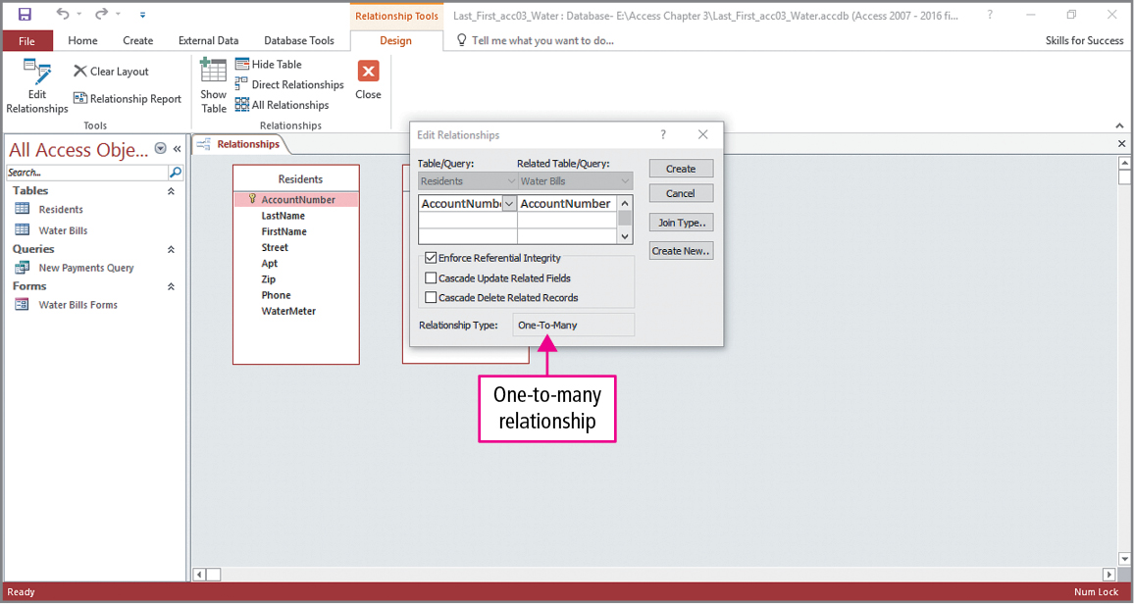
Skill 5: Use the Form Tool
Notes:
The Form Tool can quickly be used create a form for any table or query that is selected in the Navigation Pane. Two tables—Residents and Water Bill—are added to the Relationship workspace, and a relationship will be created between the tables using the common field AccountNumber. When dragging a field from the Residents table to the Water Bill table, the Edit Relationships dialog box appears. Unfortunately, in this slide, the dialog box obscures the Water Bill table. After checking Enforce Referential Integrity, click Create, and close the Relationship tab.

Slide 22
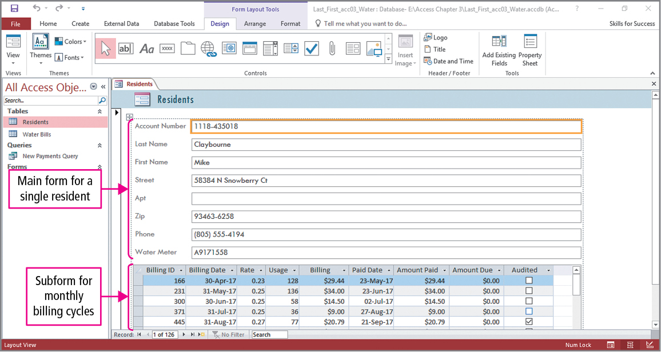
Skill 5: Use the Form Tool (cont.)
Notes:
Once a one-to-many relationship has been established between the two tables, creating a main form with a subform is simple. Just click Form in the Forms group, and the resulting form is shown in the slide. In a one-to-many form, the main form—the resident fields—display in Single Form view, and the related records—monthly billings—display in a subform in Datasheet view.

Slide 23
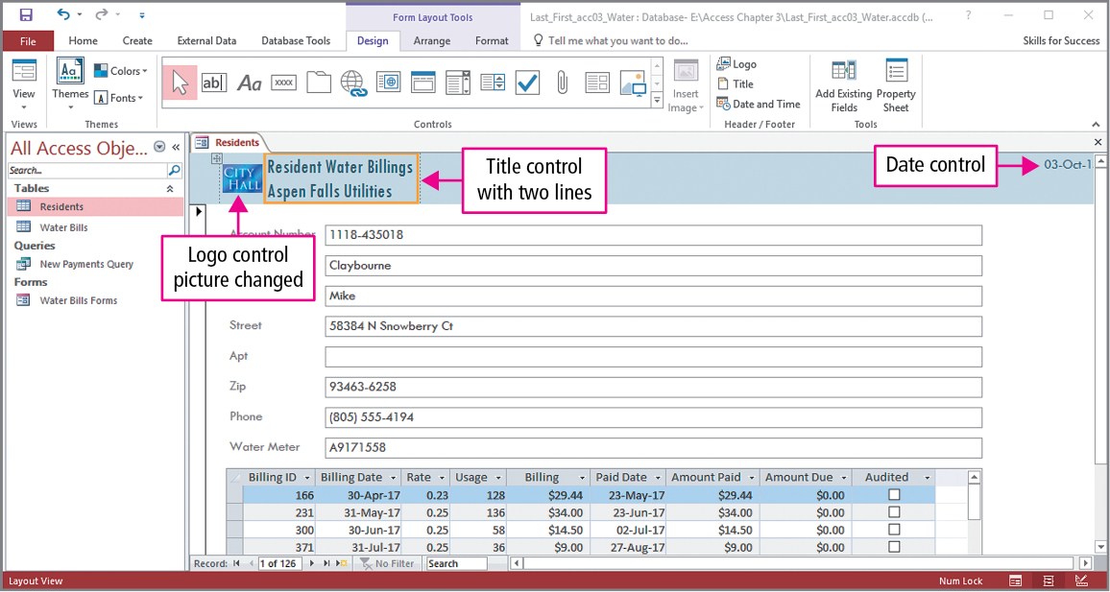
Skill 5: Use the Form Tool (cont.)
Notes:
As seen in this slide, a logo has been inserted, and a title added. This title appears on two lines, and this is accomplished by pressing Ctrl + Enter at the end of the word ‘Billings’ when typing the text. A new control with the date has also been added. Since this is a new technique, we will see how this is done. Click Date and Time in the Header / Footer group to display the Date and Time dialog box. In the dialog box, the date format is selected and the Include Time check box is cleared to exclude the time from the form. The date format selected in the text is dd-mmm-yy, which looks rather mysterious. Looking at the slide, we see that two digits are used to display the day followed by a hyphen and three letters for the month. The remainder of the date is another separating hyphen, and unfortunately, the remainder does not show, which would have been a two-digit year.

Slide 24
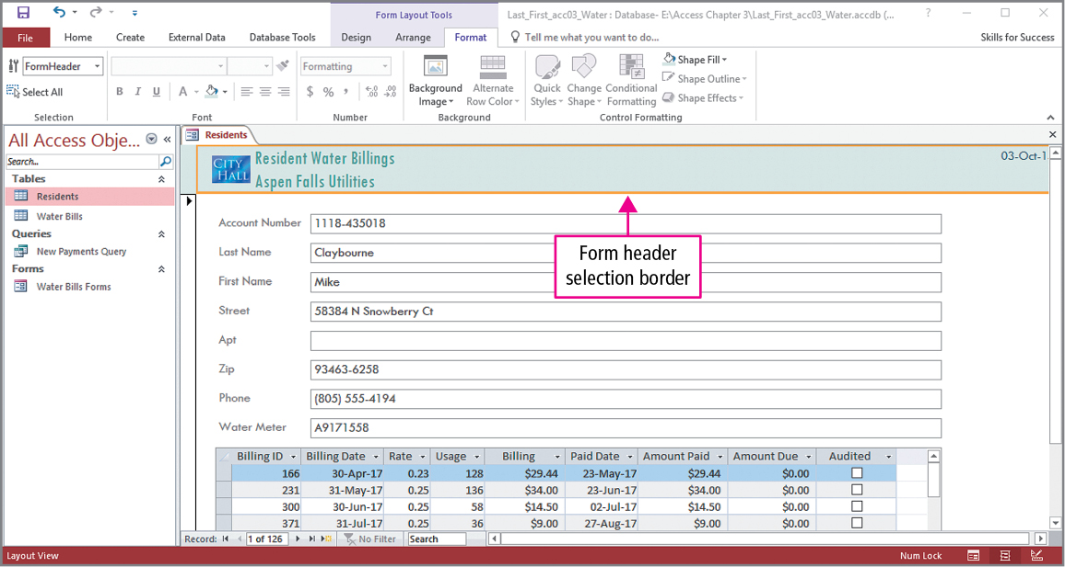
Skill 5: Use the Form Tool (cont.)
Notes:
Our final change to the form will involve changing font and background colors in the form header. The first change is just to the Title control: select it, click the Font Color arrow in the Font group, and select the desired color from the color list. The second formatting change will be done to the entire header. Click in a blank area of the header to select the entire header, and then click the Background Color arrow in the Font group, and select the desired background color from the color list.

Slide 25
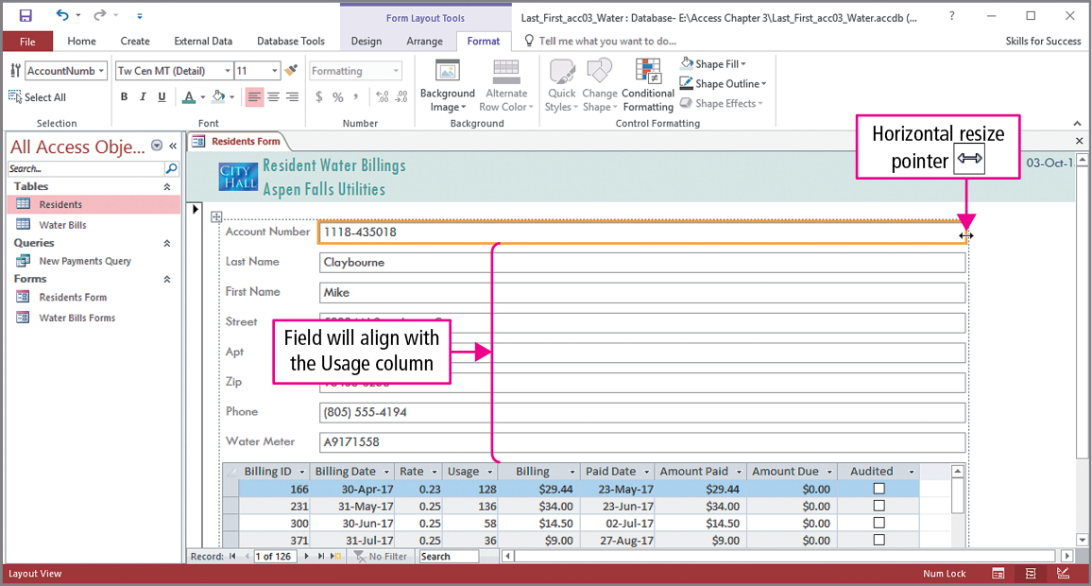
Skill 6: Work with Tabular Layouts
Notes:
Forms created with the Form tool use a tabular layout, which is a layout where the controls are positioned as table cells in rows and columns. With the form opened in Layout view, to resize the width of the rows, select any text box in the main form, point to its border, and drag to change its size. Note: The width of all columns and the width of the subform are adjusted the same amount at the same time. As shown in the slide, the Account Number text box has been selected; this is indicated by the orange border. Also notice the horizontal resize pointer, which indicates the width can be increased or decreased.

Slide 26
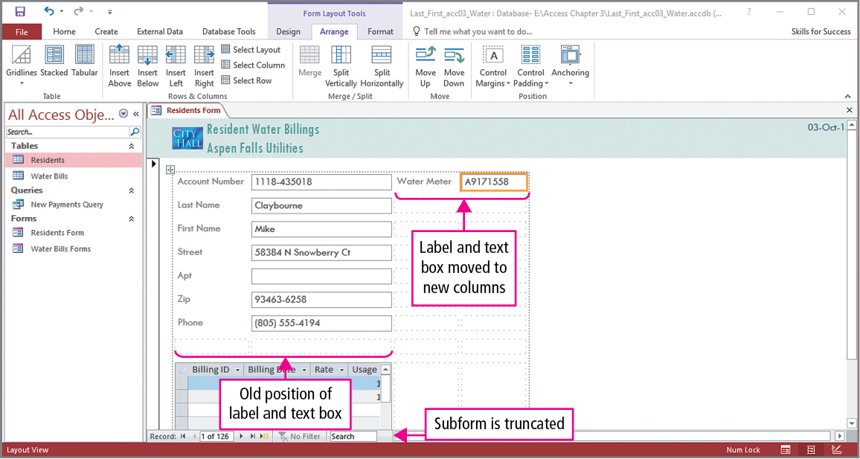
Skill 6: Work with Tabular Layouts (cont.)
Notes:
In this slide, some controls will be moved to other locations. Select any text box and click Insert Right in the Rows & Columns group on the Arrange tab twice. This inserts two columns, into which the WaterMeter label and text box will be moved. Point to the WaterMeter label, and when it becomes a four-headed arrow, move it to the new column adjacent to the Account Number text box, then repeat the process with the WaterMeter text box, moving it to the right of its label.

Slide 27
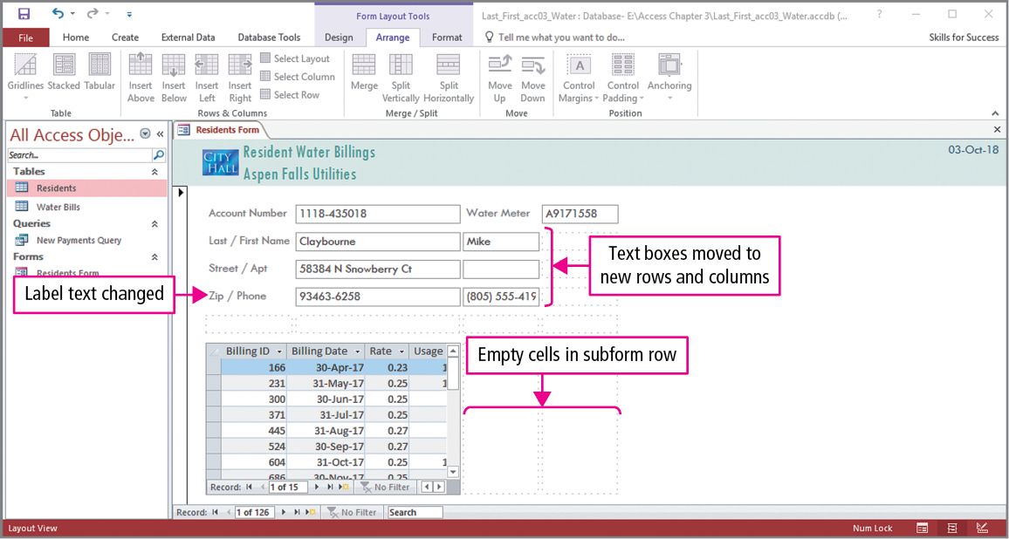
Skill 6: Work with Tabular Layouts (cont.)
Notes:
The process is repeated with just the First Name, Apt, and Phone text boxes. Since some of the text boxes are adjacent to each other, the left-most labels are double-clicked and then changed to reflect their dual use. The labels that remain unpaired with text boxes are then removed. Notice that there are two empty columns in the subform.

Slide 28
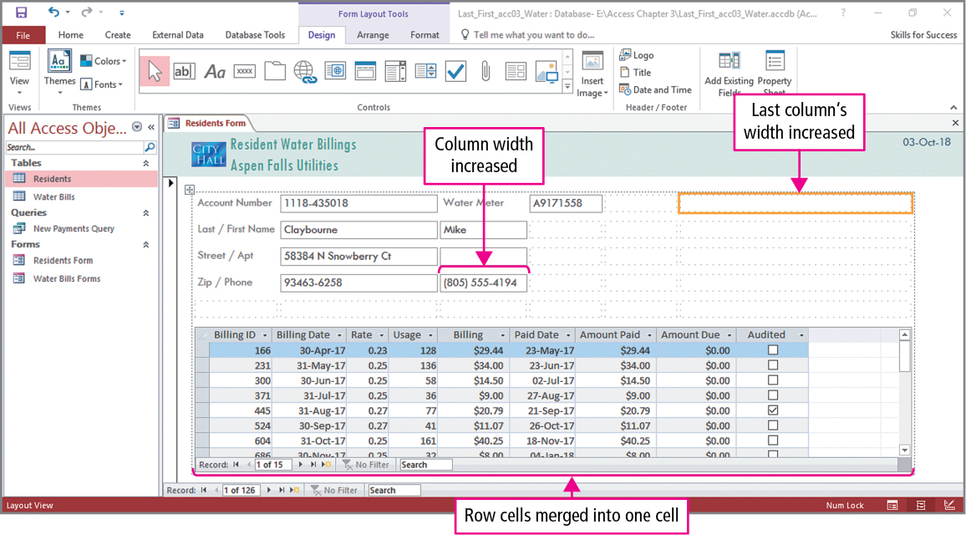
Skill 6: Work with Tabular Layouts (cont.)
Notes:
In the final slide, some changes to column widths will be made and some cells will be merged. Repeating the process that was done with the main form, click the empty cell on the right of the subform, and insert two columns to the right.
To include all five cells, click Select Row, then click Merge in the Merge / Select group. Since complete phone numbers are not displayed, the width of the PhoneNumber text box will be increased. Click the text box and then click Property Sheet in the Tools group on the Design tab. Change the Width value to the desired amount, which, in the text, is 1.2”. To display the entire subform, the width of the last column is widened in the same manner to 3.2”.

Slide 29
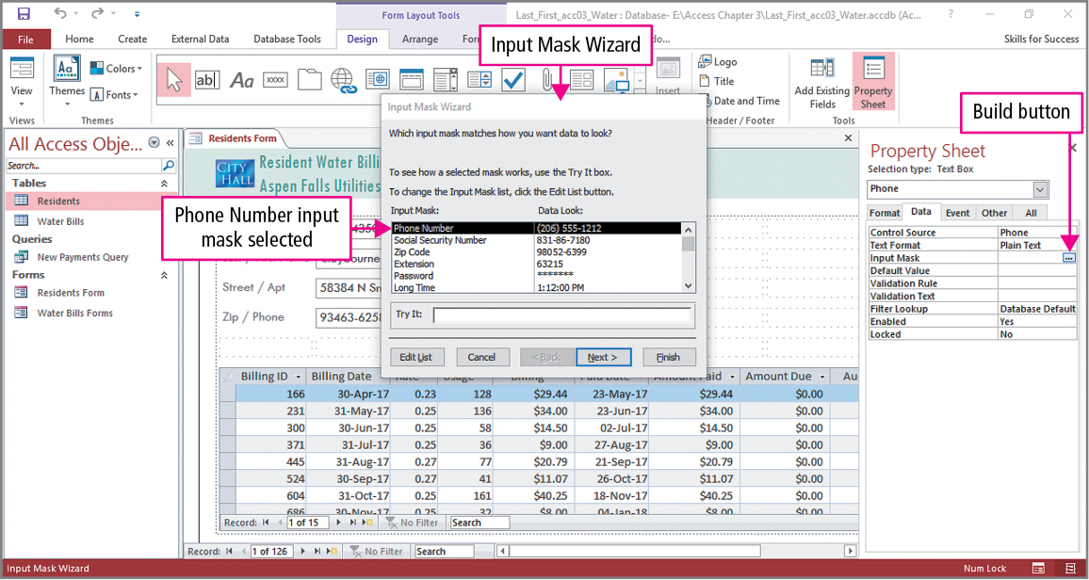
Skill 7: Add Input Masks
Notes:
An input mask is a set of special characters that controls what data are entered in a field. In this example, an input mask will be used to control phone numbers. Begin by selecting the Phone text box, then click Property Sheet in the Tools group. In the property sheet, click the Data tab, click Input Mask, and click the Build button to display the Input Mask Wizard.

Slide 30
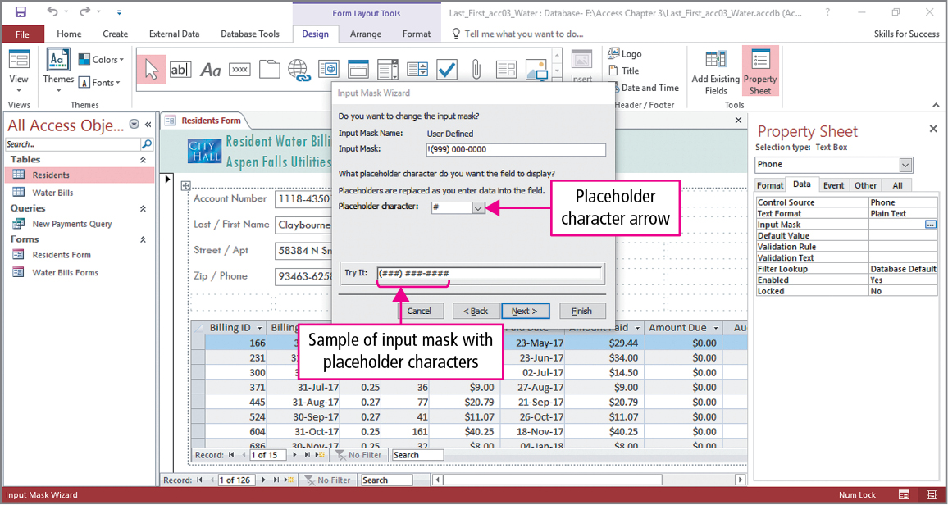
Skill 7: Add Input Masks (cont.)
Notes:
You can preview a mask in the Try It box. With Phone Number selected in the Input Mask Wizard, click Next. Click the Placeholder character arrow, and then click the number sign. Click in the Try It box. As seen in the slide, the usual phone number format is displayed using # as placeholder characters, which are input mask symbols that are replaced by data typed into the field.

Slide 31
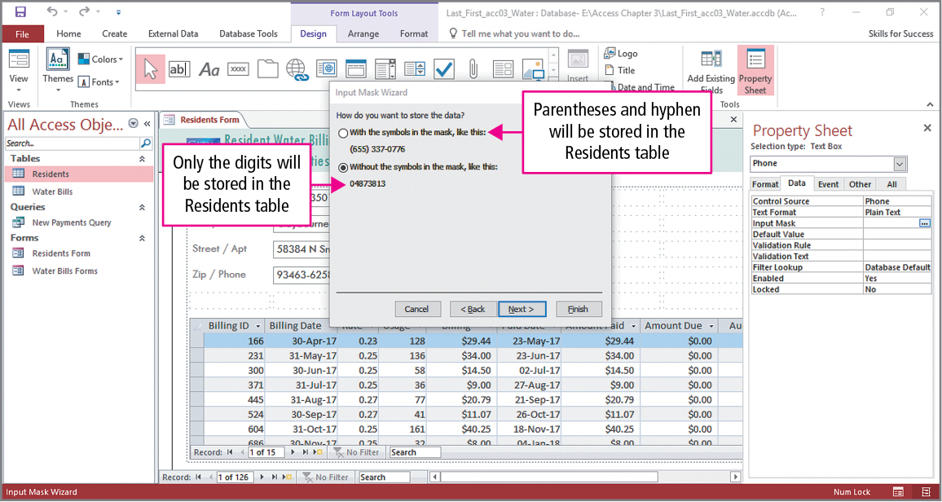
Skill 7: Add Input Masks (cont.)
Notes:
Phone numbers can be stored with or without the parentheses, hyphens, and the space. As seen in the slide, there are two option buttons, and following the text instructions, the phone numbers will be stored with the symbols included in the phone field.

Slide 32
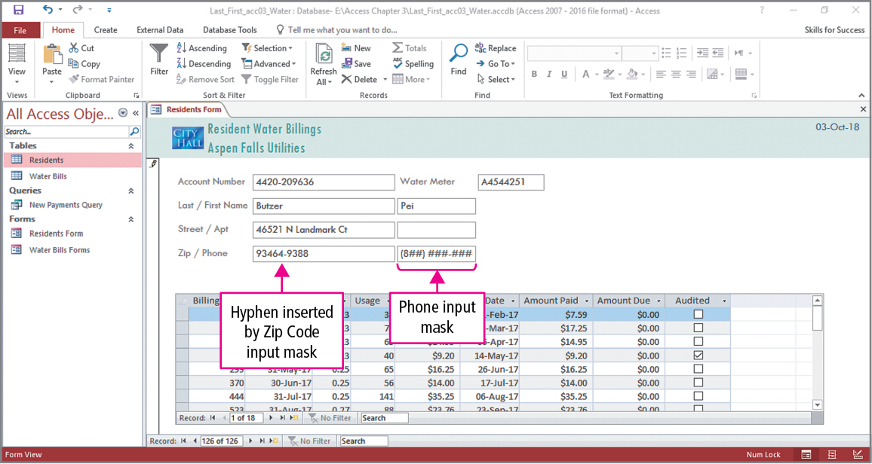
Skill 7: Add Input Masks (cont.)
Notes:
The process is repeated with the ZIP code, except a Zip Code mask is chosen. Looking at the slide, we see that the Zip Code mask uses what is called the extended ZIP+4 format, which has a hyphen between the five digit ZIP code and the specific location within the ZIP code.

Slide 33
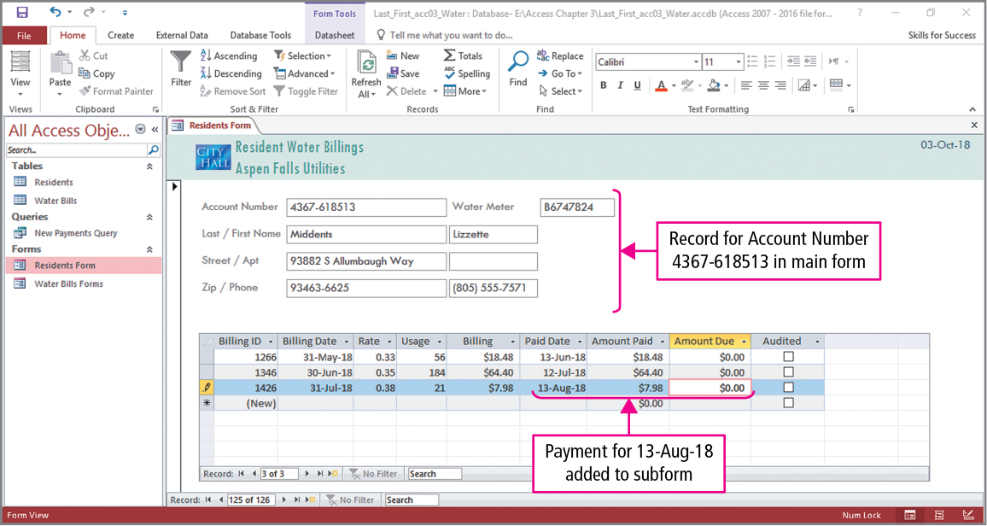
Skill 8: Change Data in One-to-Many Forms
Notes:
When using the one-to-many form, data from two tables appear on a single screen. In this example, the main form will be used to find a record, and then changes will be made in the subform. Using the textbook data, Find is used to locate account 4367-618513, and then date is changed to 13-Aug-18 and the amount is changed to 7.98. These changes are reflected in the Water Bills table.

Slide 34
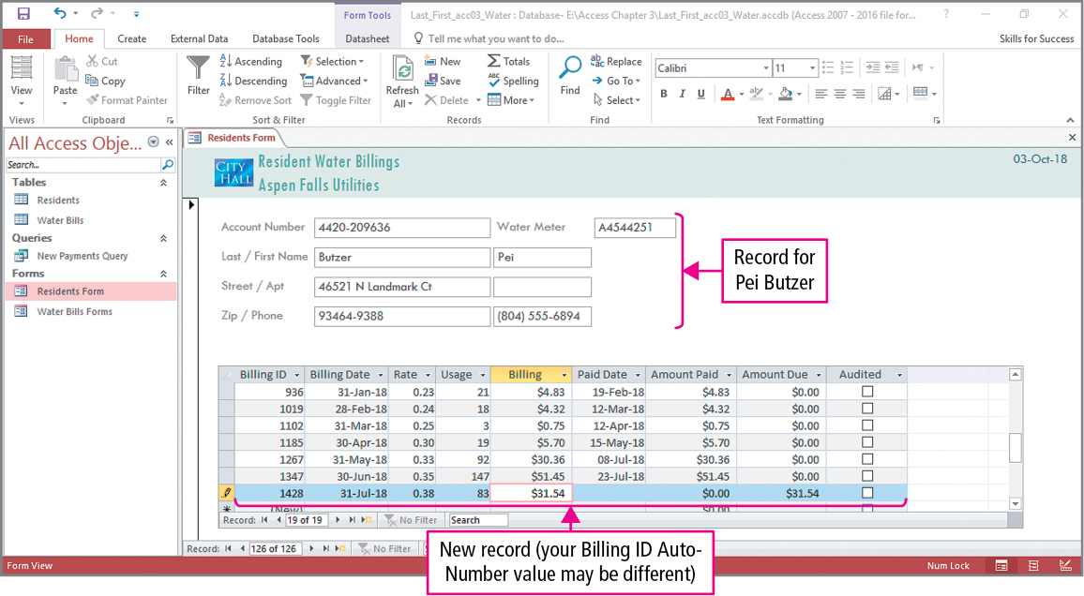
Skill 8: Change Data in One-to-Many Forms (cont.)
Notes:
In the this example, a change will be made to the subform. The New (blank) record button is clicked in the subform, and new data is entered into it. This is shown in the slide at the bottom of the subform.

Slide 35
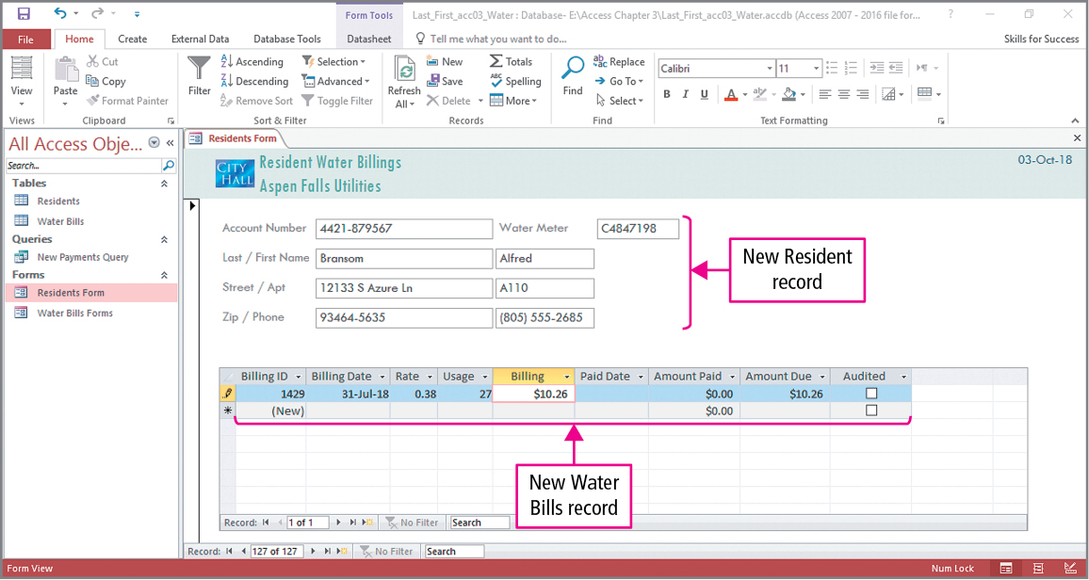
Skill 8: Change Data in One-to-Many Forms (cont.)
Notes:
Now a new record is added to the main form by clicking its New (blank) record button, and the data shown in the slide is entered. Additionally, a record is also added to the related subform, which is also shown on the slide.

Slide 36
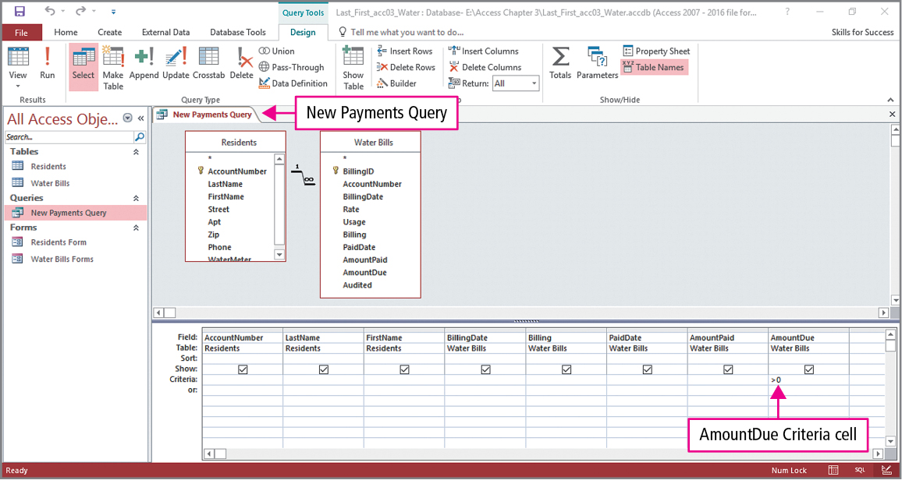
Skill 9: Create Forms from Queries
Notes:
A form can be based on a query, so only records meeting the query criteria are displayed. Using Design view, we see the New Payments query is displayed. The criterion >0 is entered in the Criteria row of the AmountDue column.

Slide 37
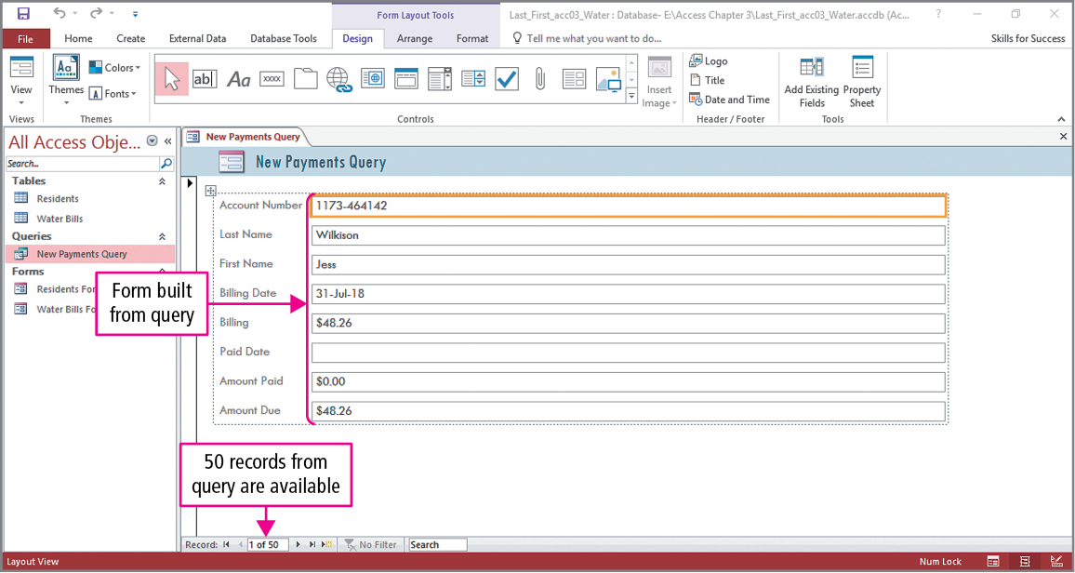
Skill 9: Create Forms from Queries (cont.)
Notes:
Running the query displays 50 records. Using this query, click Form in the Forms group, and the form shown on the slide is created.

Slide 38
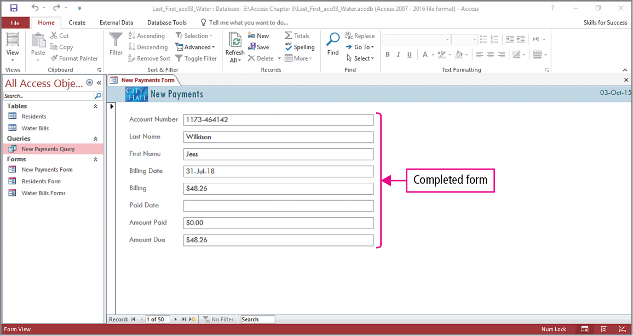
Skill 9: Create Forms from Queries (cont.)
Notes:
The form will be formatted using techniques discussed earlier. By selecting a text box and then using its Property Sheet, the width of the text boxes can be adjusted. Additionally, a logo and title are added to the form header. These changes are shown in the slide.

Slide 39
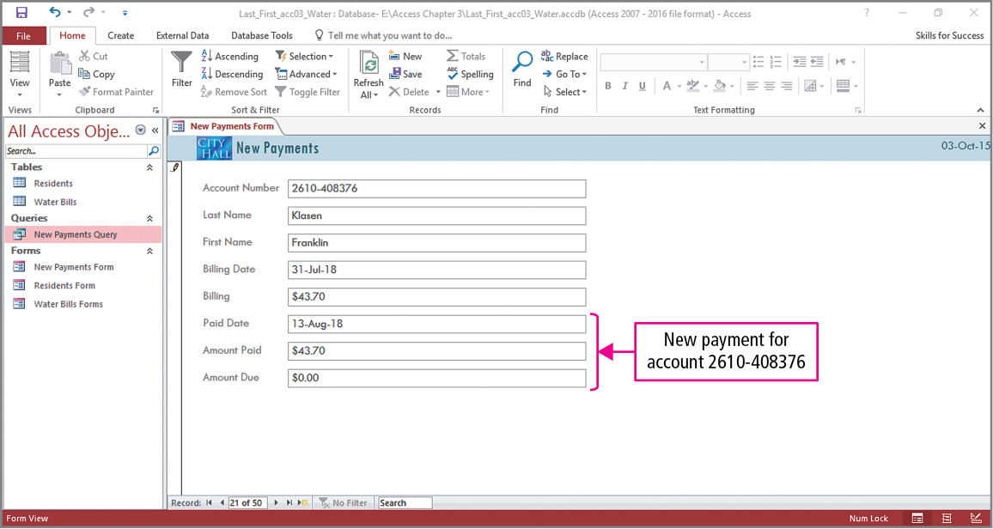
Skill 9: Create Forms from Queries (cont.)
Notes:
For the final slide, the View button is used to switch to Form view. As seen in the slide, a record is located and data are entered into two of its fields.

Slide 40
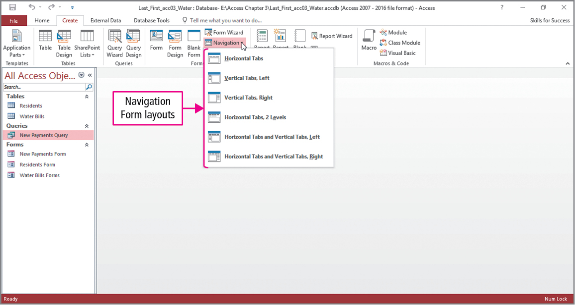
Skill 10: Create Navigation Forms
Notes:
A Navigation form is a form that contains a navigation control with tabs, which can be used to quickly open forms and reports. To add a navigation control, click Navigation in the Forms group to display a gallery of navigation form layouts. In the example shown in the slide, Vertical Tabs Left will be selected.

Slide 41
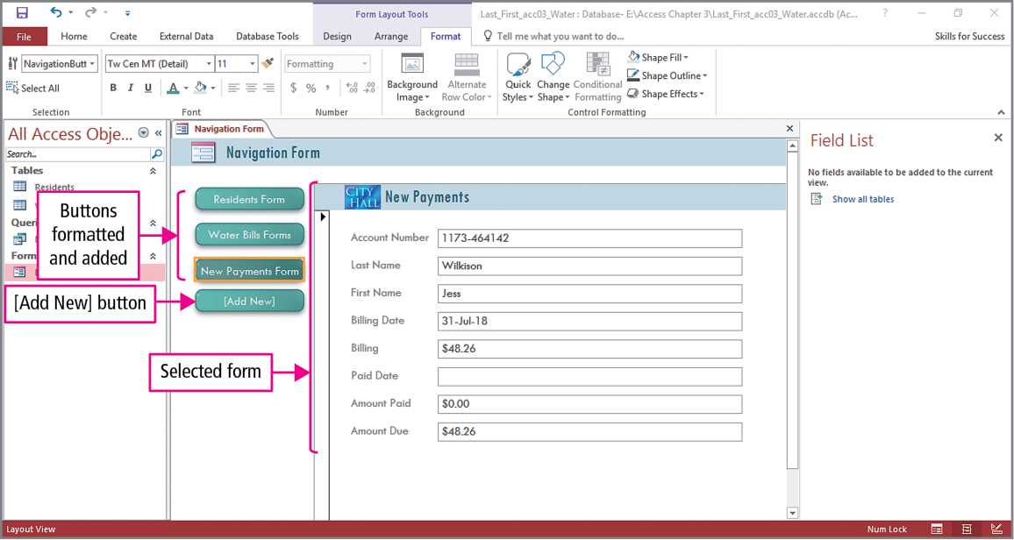
Skill 10: Create Navigation Forms (cont.)
Notes:
Control buttons are added by clicking [Add New], and can be formatted by clicking Quick styles in the Formatting group on the Format tab. In the example shown in the slide, Intense Effect – Teal, Accent 6 was selected. Formatting continues by clicking Change Shape, also located in the Formatting group, and then selecting a shape. The slide shows that a Rounded Rectangle shape was chosen. To create links to forms, drag any form from the Navigation pane to the [Add New] button. As seen in the slide, the Residents, Water Bill, and New Payments have been dragged and buttons have been created.

Slide 42
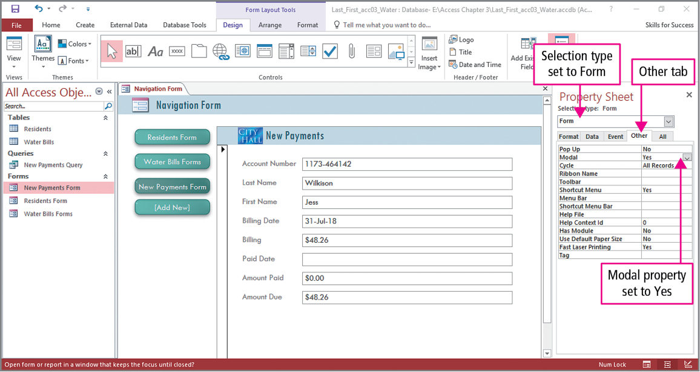
Skill 10: Create Navigation Forms (cont.)
Notes:
The form is going to be changed to a modal form, which means when the form is opened, the Navigation pane is collapsed. This is done using the form’s Property Sheet. Click Property Sheet in the Tools group on the Design tab. Since we will be making a change to the form, in the property sheet, below Selection type, click the arrow, and then click Form to display its properties. Click the Modal arrow and select Yes. Close the property sheet and form.

Slide 43
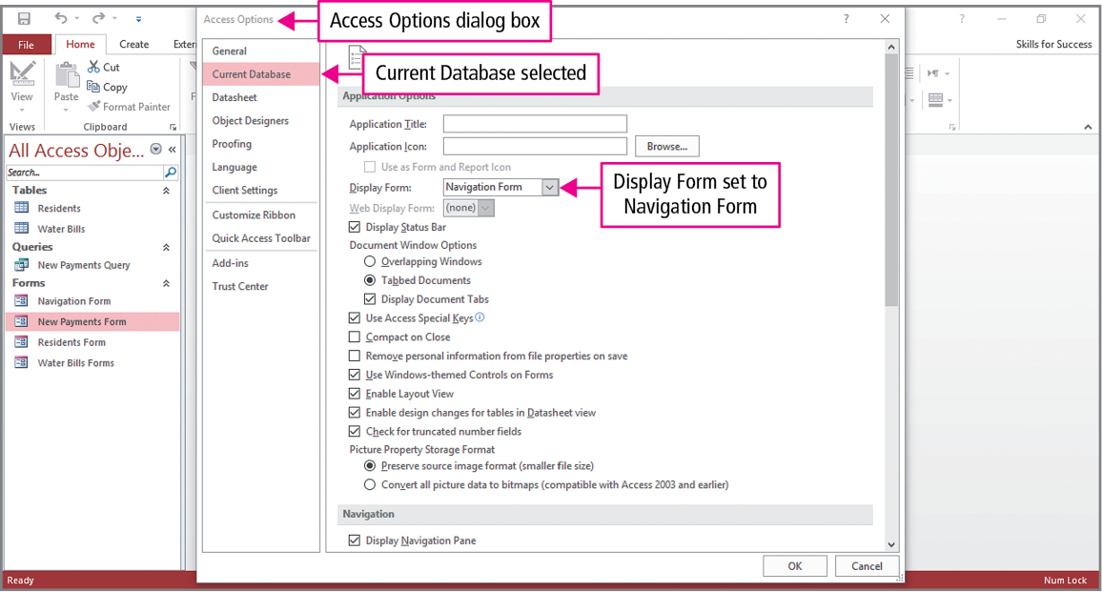
Skill 10: Create Navigation Forms (cont.)
Notes:
We finish by making a form open automatically when the database is opened. Click Options on the Files tab to open the Access Options dialog box. On the left side of the dialog box, click Current Database, click the Display Form arrow to display a list of all the database forms, and then select the desired form. In the example shown in the slide, the Navigation Form will open when the database is opened.

Slide 44
More Skills For Success
You will now practice the following additional skills:
Validate Fields
Create Databases from Templates
Import Objects from Other Databases
Back Up Databases
Notes:
You will now practice the following additional skills:
Validate Fields
Create Databases from Templates
Import Objects from Other Databases
Back Up Databases

Slide 45
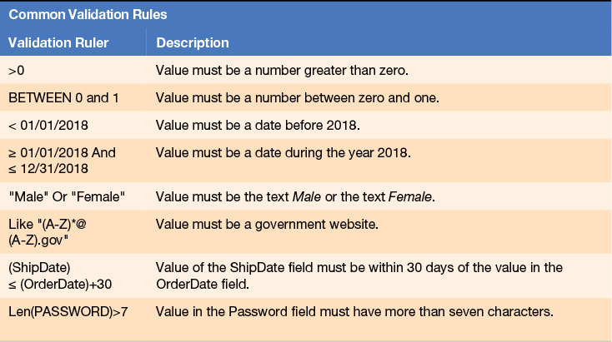
More Skills 11: Validate Fields
Notes:
Validation rules are field properties that require that specific values be entered into a field. For example, letters should not be allowed to be typed into a social security number field.
To restrict the typed data, click Validation in the Field Validation group on the Fields tab and click Field Validation Rule. A validation message can be created to display when invalid data is typed. Click the Validation button in the Field Validation group, and then click Field Validation Message. In the Enter Validation Message box, type the message.
Take a few moments to read the various validation rules and their descriptions.

Slide 46
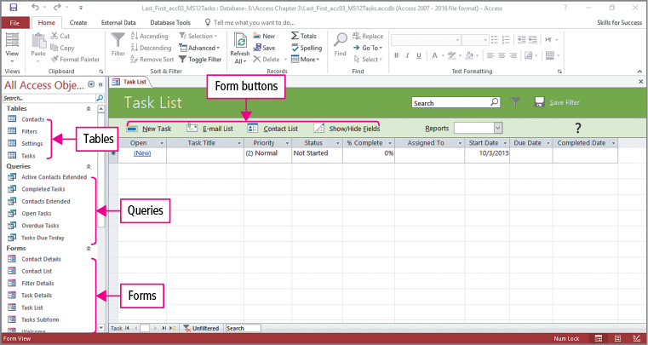
More Skills 12: Create Databases from Templates
Notes:
So far, we have used a New Blank template to create a database. However there are several pre-built templates, which may provide all the tables, queries, forms, reports, and macros needed to begin entering data immediately after the database is created.
Begin by starting Access 2016, and on the Access start screen several templates are listed. Clicking any template thumbnail displays a description of the template.
Based on the complexity of the template chosen, videos—How to use the database and how to modify the database—are provided to assist with its use.

Slide 47
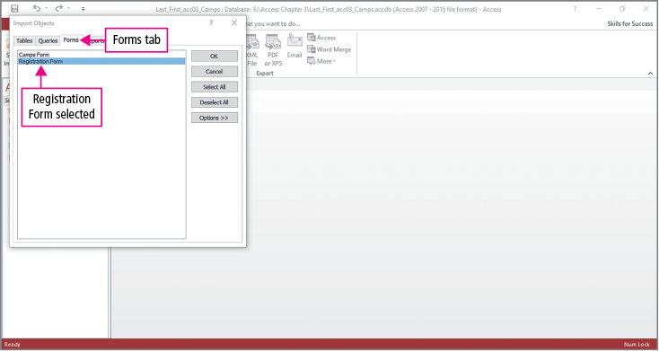
More Skills 13: Import Objects from Other Databases
Notes:
You can build a database by importing objects from other Access databases. Commonly imported objects include tables, forms, queries, reports, and macros. Use the Get External Data – Access Database dialog box to import or link Access objects into a database. When you import tables from other databases, the fields, field properties, data, and relationships with other tables are also imported.

Slide 48
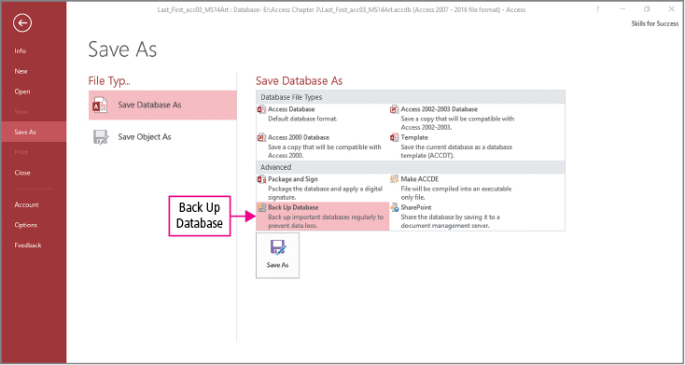
More Skills 14: Back Up Databases
Notes:
You can save a database as a template and back up databases. Missing tables, queries, or reports from a database can be restored from a backup. Use the Save As tab in the Backstage view to save a database as a template or to back up the database.

Slide 49
Summary
Forms
Form Wizard
Form Tool
Action buttons
Notes:
Forms are used to edit, delete, and add records stored in database. They are designed to be viewed on a computer screen, and reports are typically used for printing.
There are several methods for creating forms, such as the Form Wizard and the Form Tool.
Forms can be based on queries so that a subset of the data is used.
Some forms have buttons used to open other database objects.

Slide 50
Questions
Notes:
As you complete this introduction to Access, be sure you ask questions. You want to understand the concepts so that you can continue to build on them in future chapters.

Slide 51

Copyright
All rights reserved. No part of this publication may be reproduced, stored in a retrieval system, or transmitted, in any form or by any means, electronic, mechanical, photocopying, recording, or otherwise, without the prior written permission of the publisher. Printed in the United States of America.

